Slide 1
App in a Day
Microsoft Power platform
Power Apps
Power Automate
Common Data Service for Apps

Slide 2
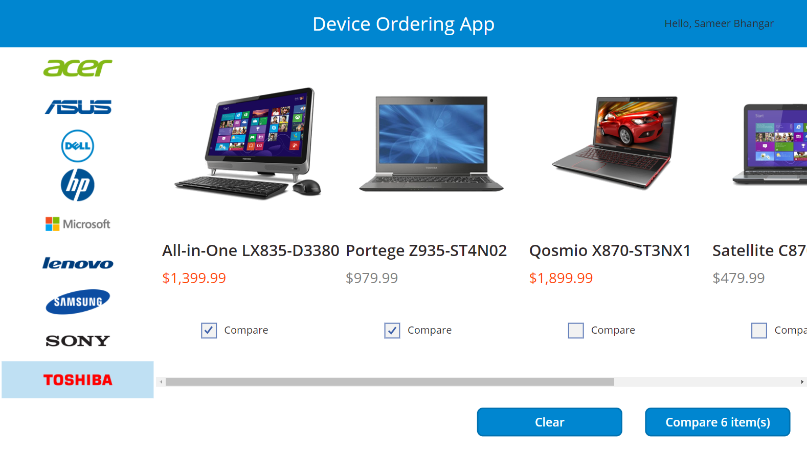
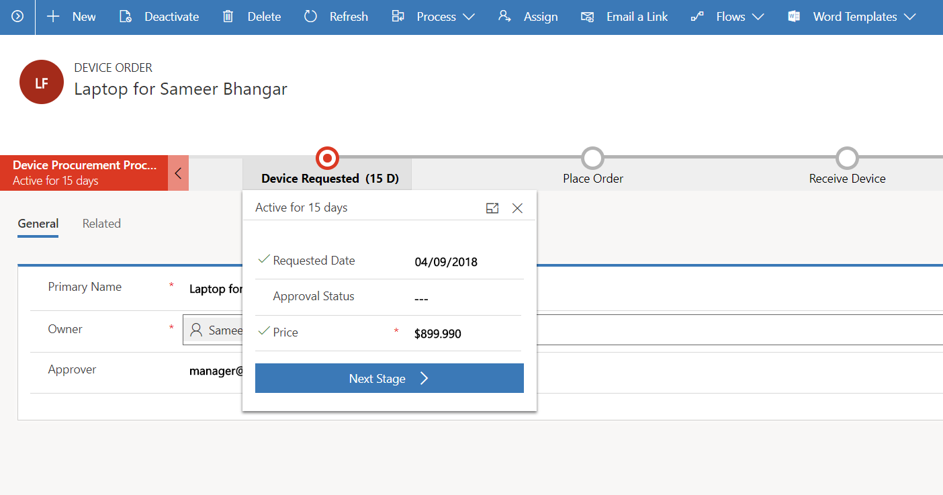
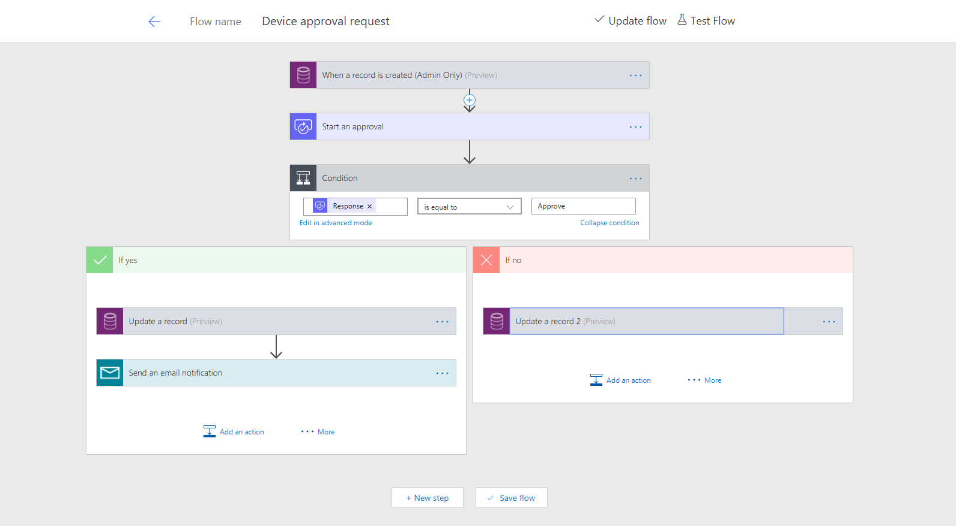
Business scenario
Imagine an organization where every three years employees go through a hardware refresh cycle.
We will streamline the device order, procurement and approval process and view aggregate reports.
The employee-facing device ordering app needs to run in a web browser and on mobile devices.

Slide 3
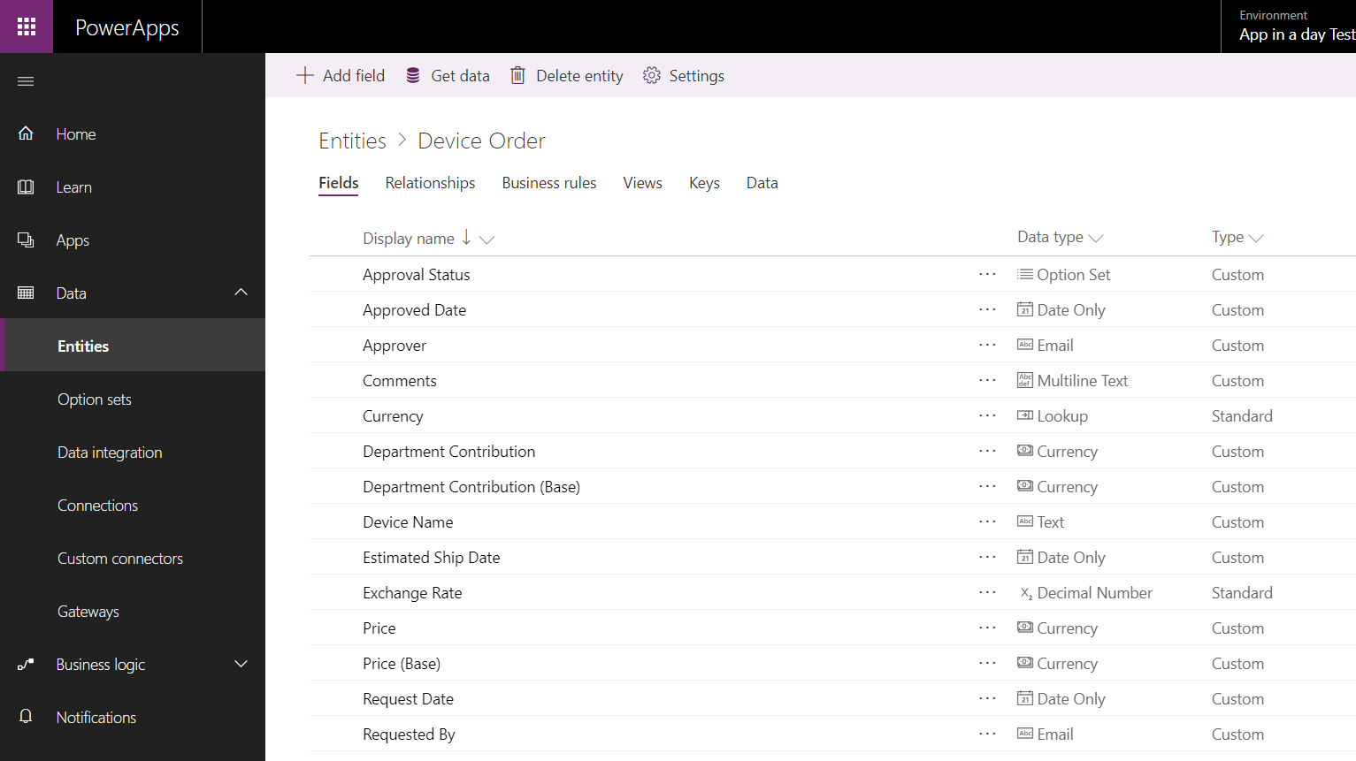
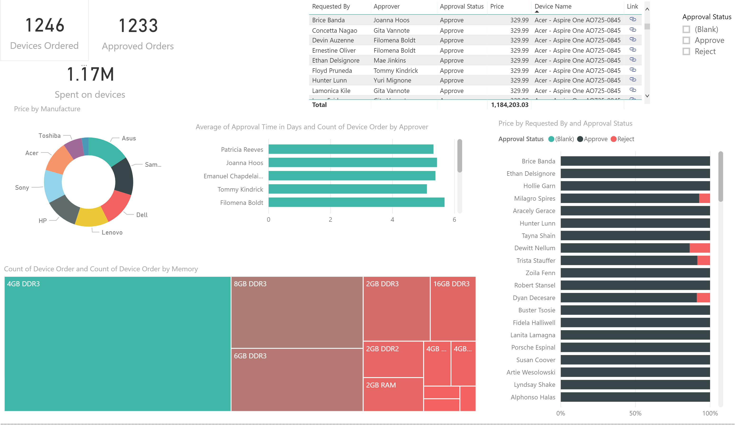
Lab objectives
Build a Power Apps Canvas App for employee facing device ordering experience
Use the Common Data Service for Apps (CDS for Apps) to store the device orders in the cloud
Build a Power Apps Model-driven App to complete the procurement process
Use Power Automateto build an approval workflow for device approval
Use Power BI to visualize device order data (note: this module is optional)

Slide 4
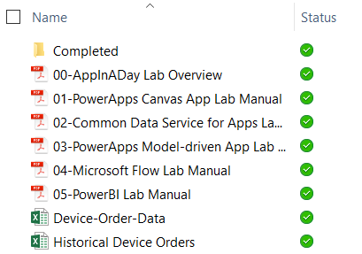
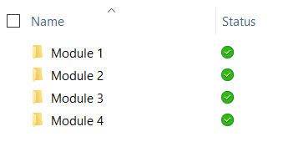
Lab content
Lab docs:
Package: http://aka.ms/appinaday
Unzip the package on your local machine
Follow instructions: “00-AppinaDay Lab Overview.pdf”
Contains 4 modules with a lab doc for each:
01-Power Apps Canvas App
02-Common Data Service for Apps
03-Power Apps Model-driven App
04- Power Automate
Completed Modules:
The \Completed folder contains solution packages that you can import
e.g. To work on Module 5 without completing previous modules -> see \Completed\Module4
Completed modules:

Slide 5
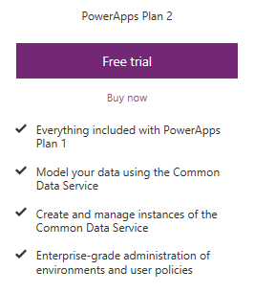
Pre-requisites
Valid Power Apps Plan 2 license:
Common Data Service usage requires a Power Apps Plan 2 license
Visit https://powerapps.microsoft.com/pricing/ and click Free Trial
If you are unable to acquire a trial license:
Ask the instructor for a trial user account that you may use for this session OR
Create your own Office 365 trial tenant – http://aka.ms/Office365E5Trial
Power Apps authoring environment:
Launch https://make.powerapps.com using any modern browser
Power Apps mobile apps (Optional):
PowerApps – iOS : https://aka.ms/PowerAppsiOS
PowerApps – Android : https://aka.ms/PowerAppsAndroid

Slide 6
Provision environment and Common Data Service
This lab requires a new Power Apps environment and CDS database that was provisioned for this class.
Go to the Power Apps Admin center – http://admin.powerapps.com
Select +New environment, fill out the form using a Trial Environment, and select Create Environment
Select the Create database option
Fill out the form, check the box to include sample apps and data and select Create my database
Your new environment will be added to the list of environments
IMPORTANT: The database has not yet been provisioned
Select the environment you just created
Wait for the “Provisioning database…” message to go away
You may need to refresh the screen every couple of minutes
Once the provisioning is complete, then proceed to create apps in the environment

Slide 7
Module 1: Power Apps Canvas App
Hands-on-lab

Slide 8
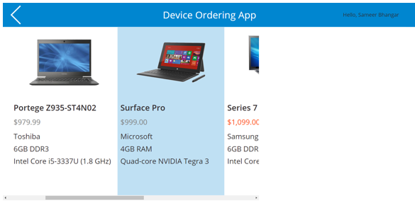
Module 1:Learning objectives
Sign-in and create a new Canvas App
Connect to data sources
Filter data
Work with multiple screens and navigation
Customize the user experience – galleries and controls

Slide 9
Module 2: Common Data Service for Apps
Hands-on-lab

Slide 10
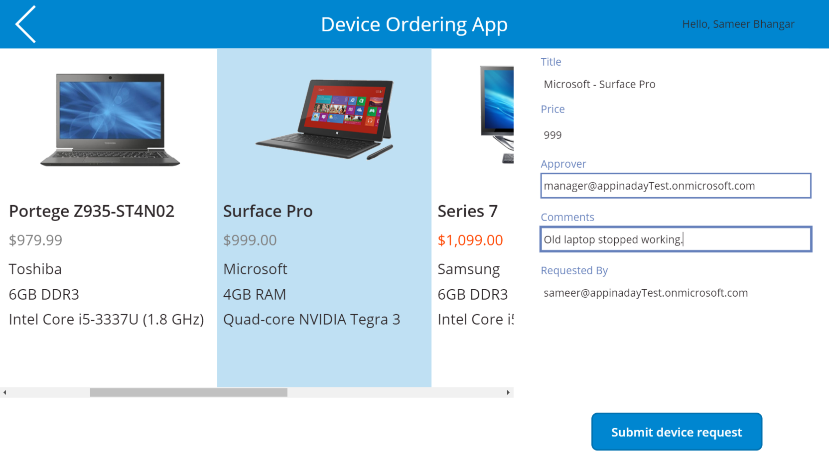
Module 2:Learning objectives
Provision a CDS database
Get familiar with standard entities
Create a custom entity
Customize entity fields and option sets
Create calculated fields
Use the Canvas app form control to save data to CDS
Use the Office365 connector to get user’s manager info
Configure Canvas app settings
Save and share a Canvas app
Run a Canvas app on a mobile device

Slide 11
Module 3: Power Apps Model-driven App
Hands-on-lab

Slide 12
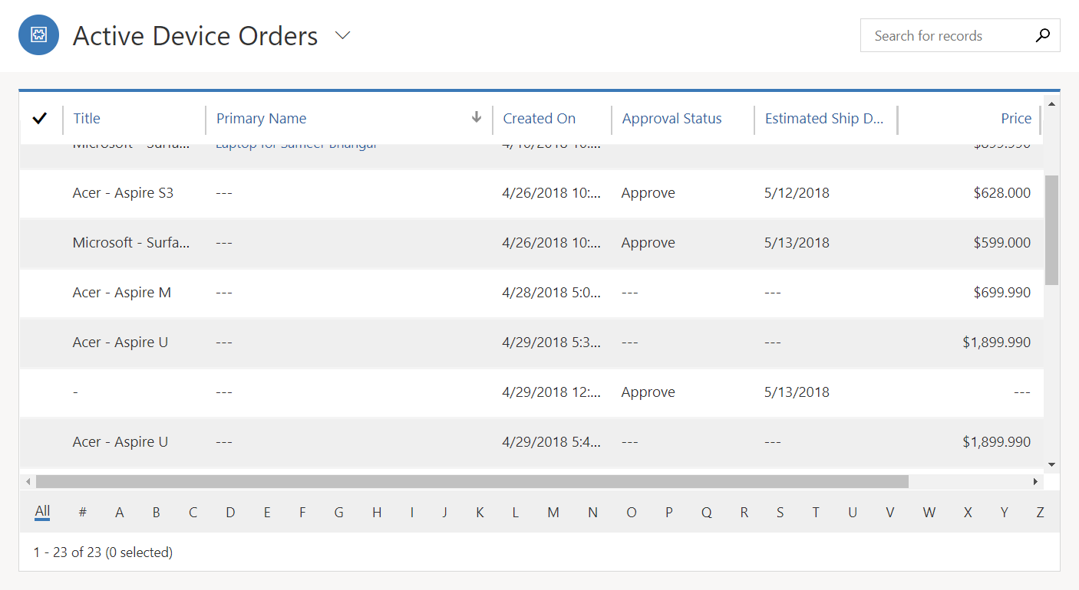
Module 3: Learning objectives
Create a standalone Model-driven app
Customize forms for the Model-driven app
Create a Business Process Flow

Slide 13
Module 4: Power Automate
Hands-on-lab

Slide 14
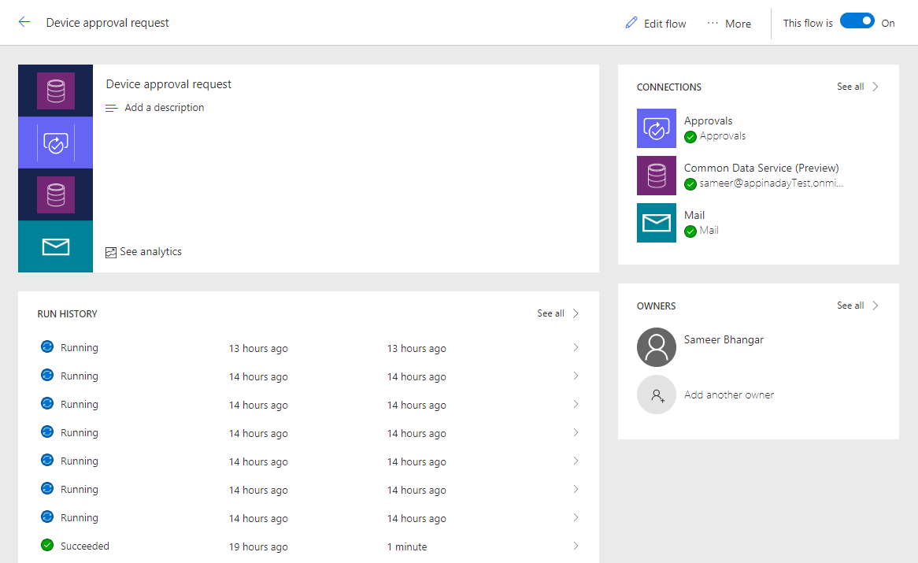
Module 4:Learning objectives
Trigger a flow when a new record is created in CDS
Send an approval request
Conditional branching based on the approval response
Send email notifications
Update the CDS record with the approval status and the approver’s comments
Use the approval center on web and mobile
Check the status of flow runs

Slide 15
Supplemental labs
S01- Power BI
S02- Microsoft Teams
S03- Power Virtual Agent
These labs continue to build the app functionality from the prior labs

Slide 16
Crisis response labs
CR01- Crisis Communication App
CR02- Crisis Communication App
These labs are independent of the AIAD labs. They can be completed in the AIAD environment, or another non-production instance.

Slide 17
Lab survey
http://aka.ms/AIADSurvey

Slide 18
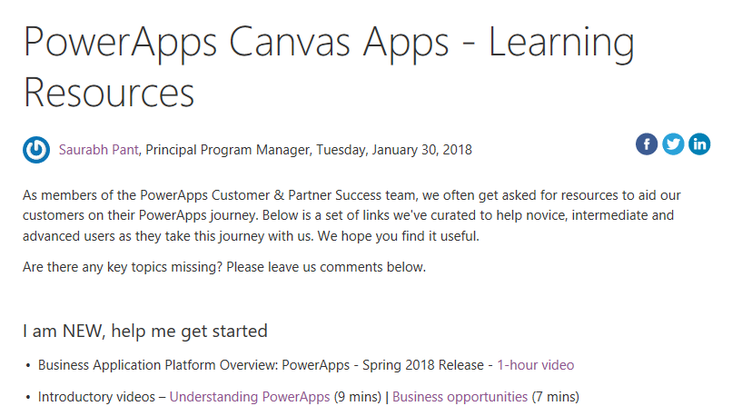
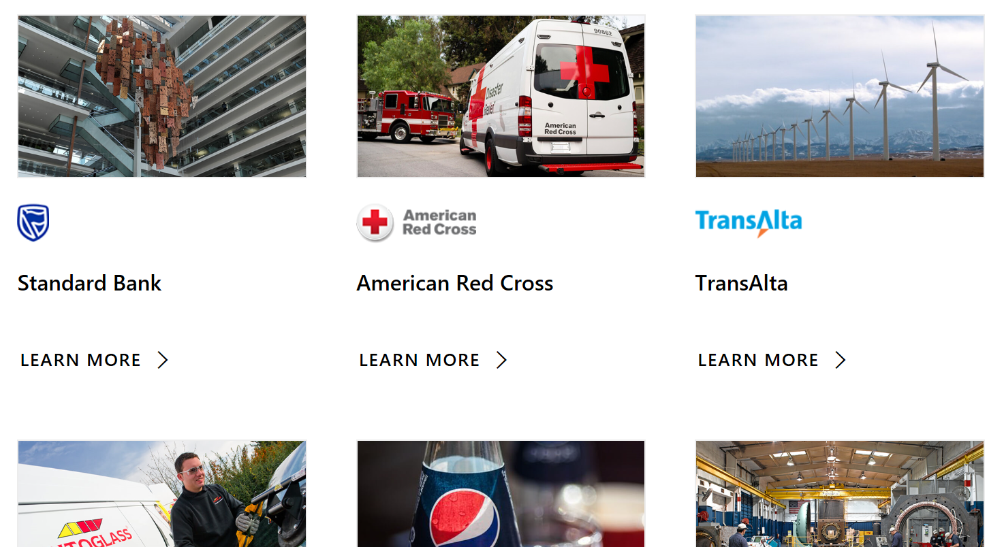
Learning resources
http://aka.ms/powerapps-resources
http://aka.ms/flow-resources
Customer stories
http://aka.ms/PowerAppsStories
http://aka.ms/GJPepsiVideo
http://aka.ms/ArrivaVideo
http://aka.ms/HeathrowVideo

